Slide 1

Rockbuster Stealth Inc.
Jacob Yount

Slide 2

Introduction
With the everchanging marketplace, Rockbuster is looking to capitalize on the streaming trend and use its movie rights to begin at home movie streaming.
We will be looking at some of their data to get a better grasp on how they can improve and implement this effectively.

Slide 3


Top selling films
Lowest selling films
Top selling genres
Lowest selling genres
Rental Duration
Top Countries for Sales
Primary
Goals

Slide 4
Company Overview
Total Stores – 2
Total Staff - 2
Total Customers – 599
Total Inventory - 16,044
Total Revenue - $61,312.04
Countries Served – 109
Total Movie Titles – 1000
Total Movie Languages - 6
Total Genres - 20

Slide 5
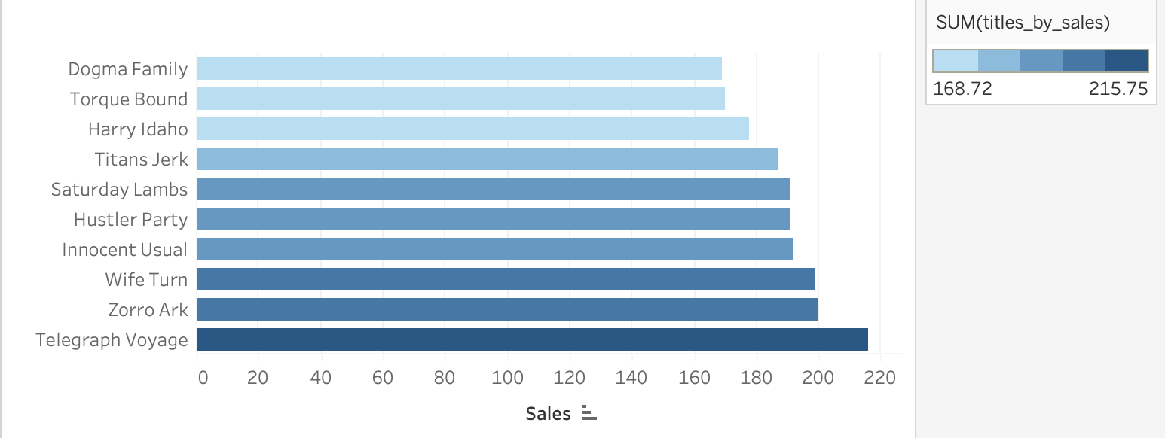
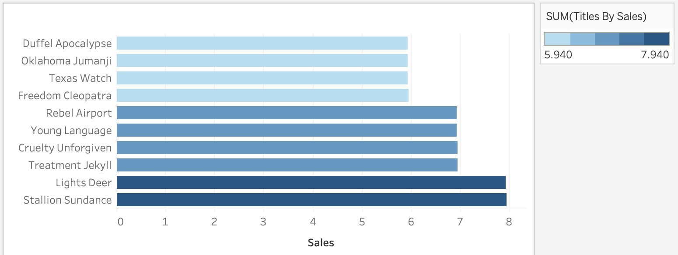
Highest/Lowest Selling Movie Titles
These two graphs represent the top 10 highest revenue and top 10 lowest revenue movie titles.
Telegraph Voyage is the top selling film, with $215.75 in revenue.
The lowest revenue films are a four-way tie. Those titles only sold $5.94 and are indicated in light blue on the graph to the left.

Slide 6
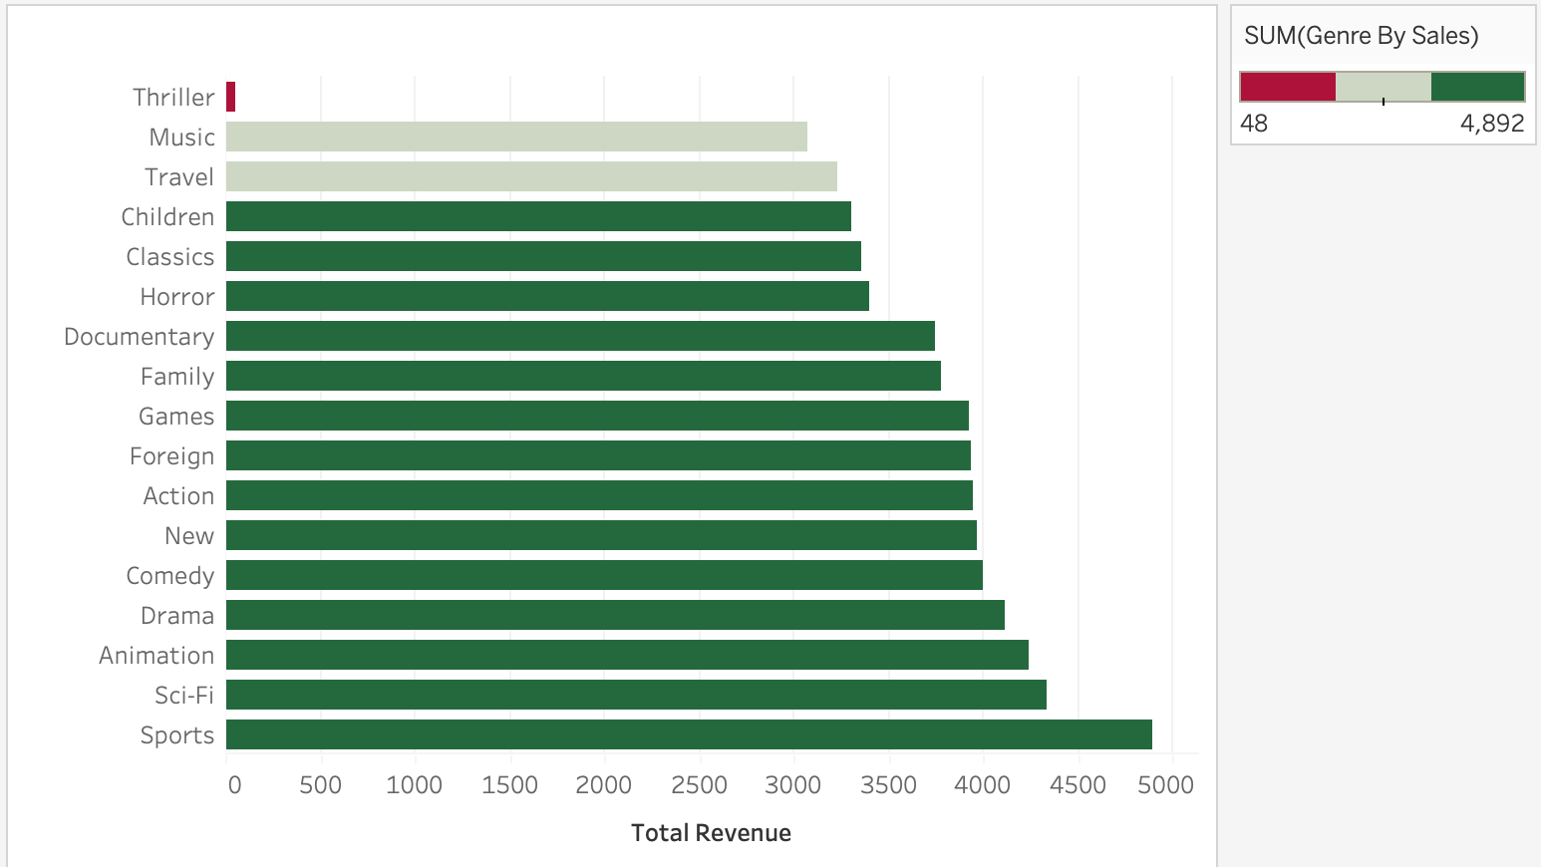
Revenue By Genre
This graph represents the total revenue from each genre. From this we can see that’s Sports is the highest grossing genre by far, and Thrillers are very far behind.

Slide 7
Rental Habits
Genre | Duration
Thriller | 6 days 26:19:42
Sports | 4 days 29:04:31
Comedy | 4 days 28:48:17
Games | 4 days 28:29:40
Music | 4 days 26:01:21
Sci-Fi | 4 days 25:57:29
Documentary | 4 days 25:32:05
Family | 4 days 25:28:22
New | 4 days 24:46:40
Horror | 4 days 24:43:30
Foreign | 4 days 24:14:17
Action | 4 days 24:01:34
Classics | 4 days 23:56:49
Children | 4 days 21:56:59
Animation | 4 days 21:55:55
Drama | 4 days 21:27:27
Travel | 4 days 20:12:24
Except for Thrillers, most movies are rented for a little over 4 days.

Slide 8
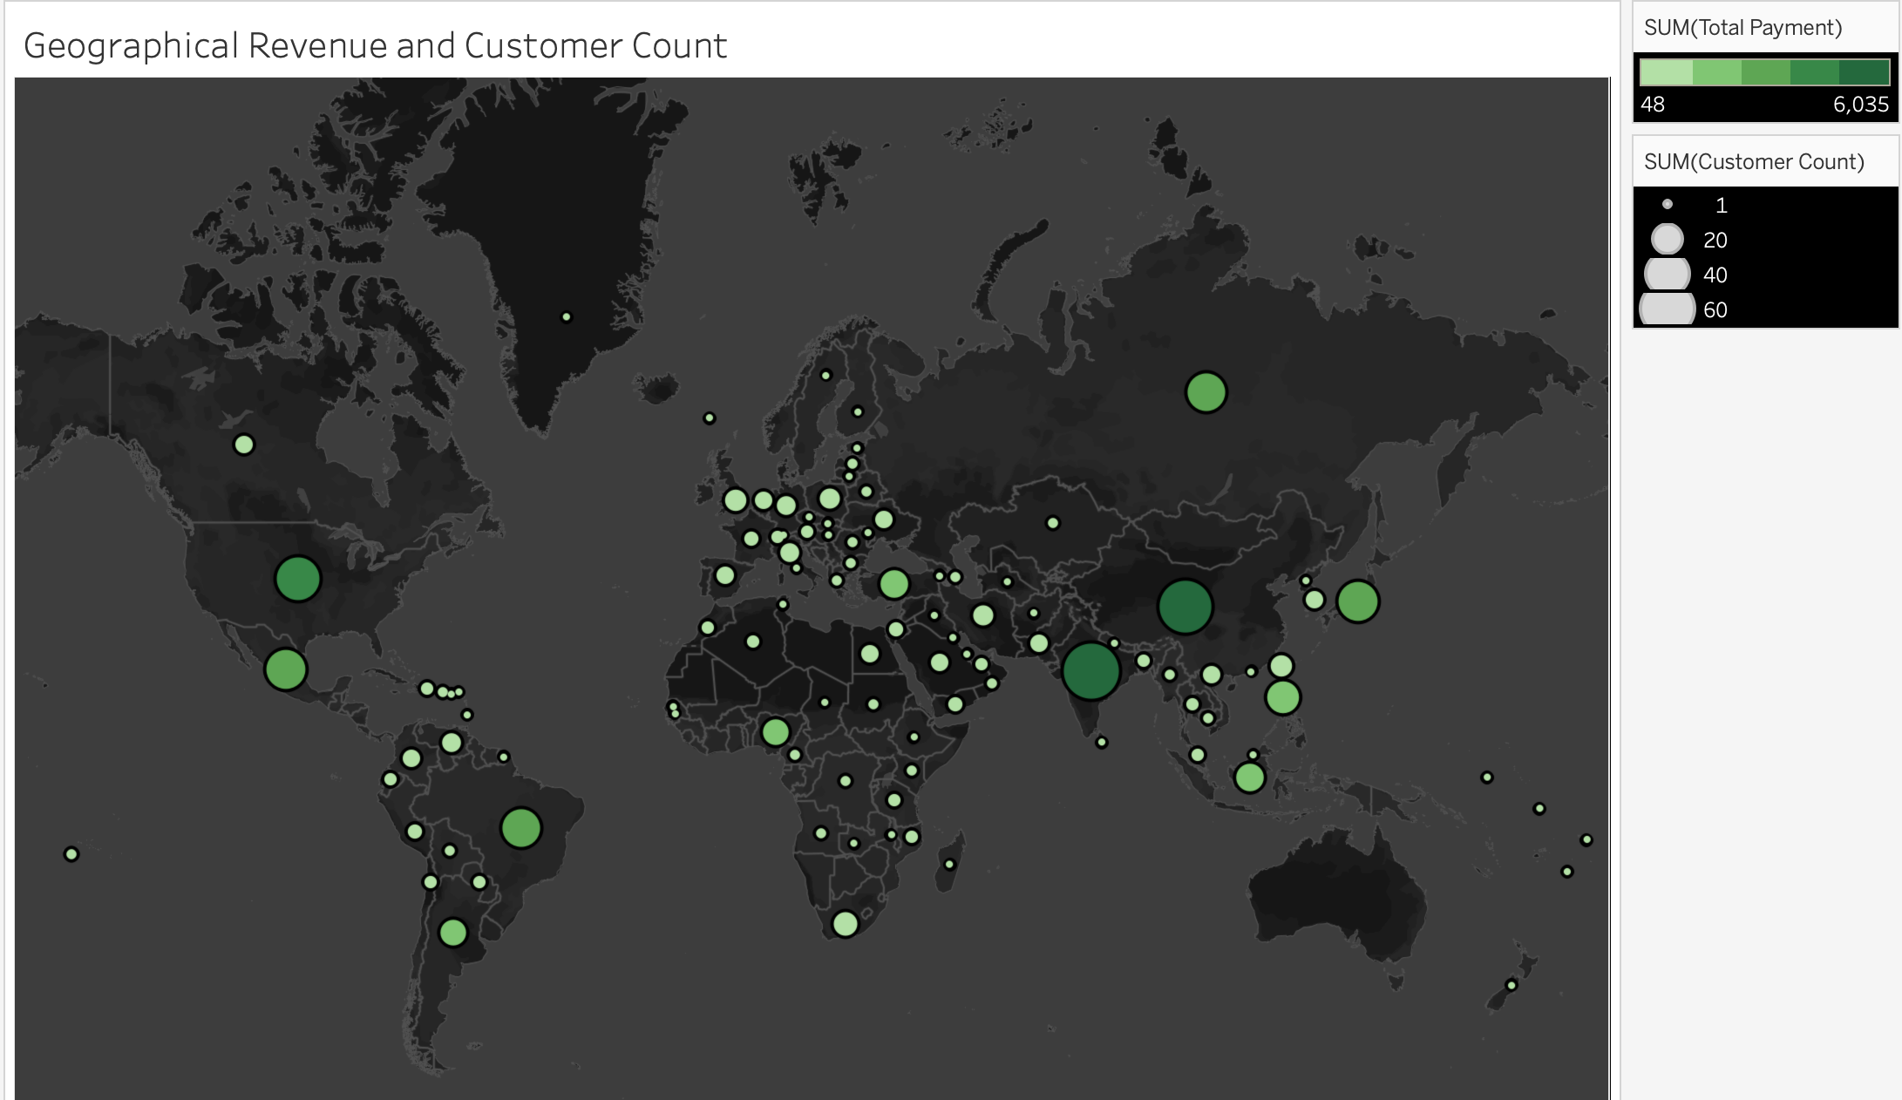
Geographic Revenue and Customer Count
India has the most RockBuster customers, and the highest revenue as well.
Country | Customer Count | Total Amount Sales
India | 60 | $6034.78
China | 53 | $5251.03
United States | 36 | $3685.31
Japan | 31 | $3122.51
Mexico | 30 | $2984.82
Brazil | 28 | $2919.19
Russian Federation | 28 | $2765.62
Philippines | 20 | $2219.7
Turkey | 15 | $1498.49
Indonesia | 14 | $1352.69

Slide 9


Summary
Apart from the Thriller genre, all other genres contributed to Rockbusters growth financially.
Rockbuster’s prime markets are Asia, headed by India and North America with the United States and Mexico.
Most films were rented for a little more than 4 days.

Slide 10

Recommendations
North America and Asia should be your primary targets as they have your highest customer base.
Look to grow your markets in Europe and Australia to match what you are producing in Asia and North America with a market plan, maybe a rewards system for frequent renters or streamers.
Look into your Thriller genre to see what could be the issue with its rental revenue.
Increase your library across all genres.

Slide 11


Thank you
Jacob Yount
jacobk.yount@gmail.com

